Slide 1
Operating System Project #1
Fall 2015

Slide 2
Goals
Git Source Control
Scheduling
Implement wait queue
Applying Priority
Priority inversion prevention

Slide 3
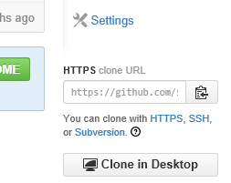
Git Hub - Start
Configure user information for all local repositories
git config --global user.name [GitHub ID]
git config --global user.email [GitHub email]
Check your team's repository in GitHub
Download a project and its entire version history
git clone [clone URL]
ex) git clone https://github.com/snucseos15f
/team01.git
git push –u origin master
Results
* [new branch] master -> master
Branch master set up to track remote
branch master from origin.

Slide 4
Git Hub – Apply
At the beginning
Create a new branch
git branch [branch name]
Move to the new branch
git checkout [branch name]
After modifying your local source codes
Snapshot the file in preparation for versioning
git add [file name]
List all new or modified files to be committed
git status
Record file snapshots permanently in version history
git commit –m "[comment]"
Upload all local branch commits
git push origin [branch]

Slide 5


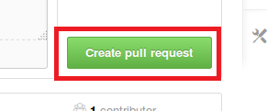
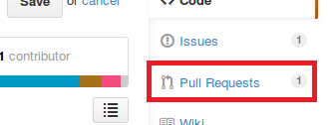


Git Hub – Merge
Move to the branch in order to merge
Pull request (to the repository owner)
Other members review the request and merge

Slide 6

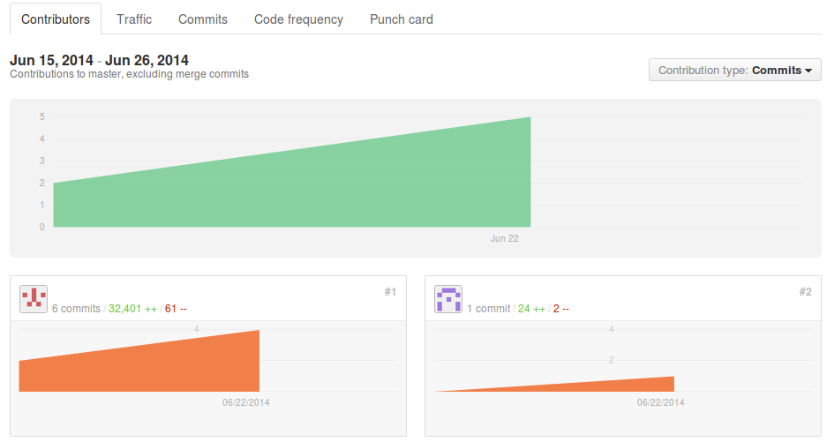
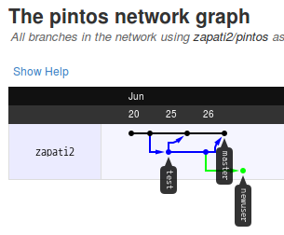
Git Hub – Results
Check out each member's contribution
Project progress

Slide 7
Project Overview
Wait Queue
When a thread goes to sleep state, make Pintos use wait queue (instead of busy wait)
It will be used in 'filesys' project
Priority Scheduling
Implement priority scheduling
The thread that has higher priority should run first (sort a ready queue according to the priority)
Solve priority-inversion problem by priority-donation

Slide 8
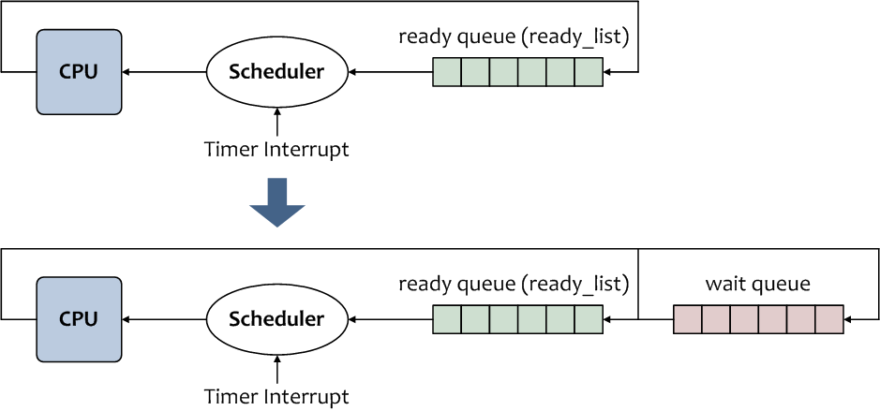
Implementing Wait Queue

Slide 9
Replacing Busy Waiting with Block Awake
timer_sleep() in devices/timer.c
Suspends execution of the calling thread until time has advanced at least x timer ticks
The time unit is tick (100 ticks occur per second)
※ The time unit is not a second
In original Pintos, timer_sleep() is implemented by Busy Wait
The thread spins in a loop checking the current time and calling thread_yield() until enough time has gone by

Slide 10
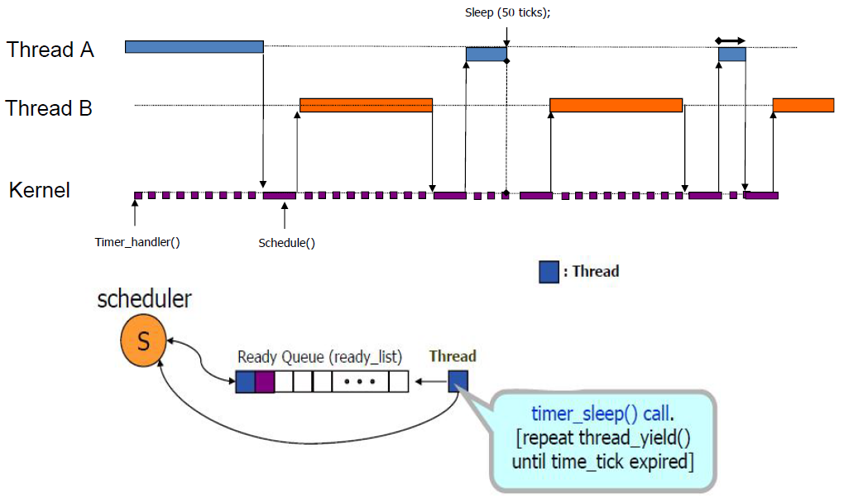
Pintos Scheduling

Slide 11
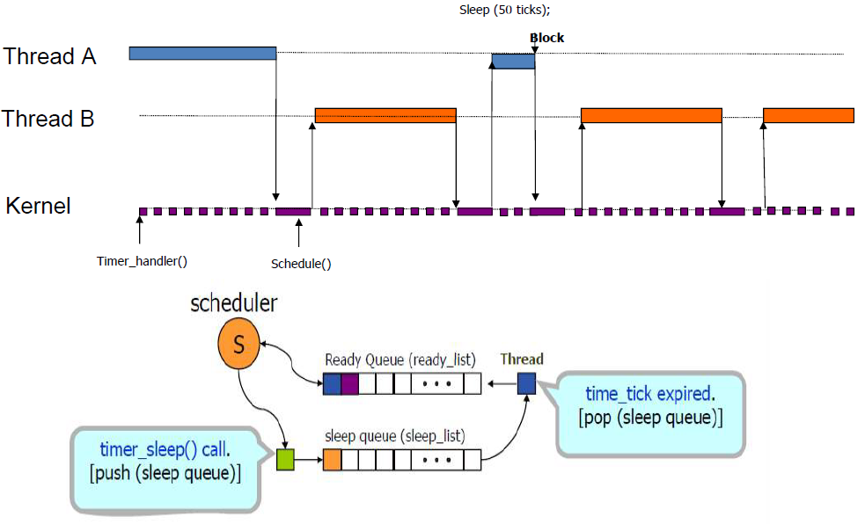
Removing Busy Waiting

Slide 12
Re-implement it to avoid busy waiting
When thread_sleep() is called
thread block → wait queue
When the timer is elapsed
thread awake → ready queue
Timer_sleep(int64_t ticks)
{
int64_t start=timer_ticks();
ASSERT (intr_get_level()==INTR_ON);
while(timer_elapsed(start) < ticks)
thread_yield();
}
thread_sleep();
Busy Waiting!

Slide 13
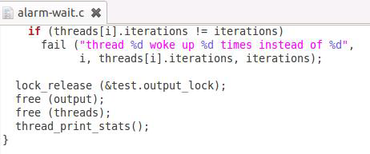
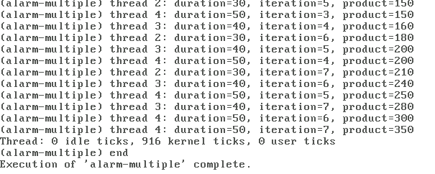
Designing and Implementing Thread-awake Algorithm
Design an efficient thread block-awake algorithm
Depending on implementation process of Pintos
Test

Slide 14
Priority Scheduling
ready_queue
When a scheduler pushes threads to ready queue, should sort the threads according to priority
When priority is changed or a thread is created or terminated
Change the running thread immediately according to priority
priority donation
Modify 'lock' in synch.c and synch.h

Slide 15
Note) list structure
Overview
for loop
list_begin←head.next
list_entry←stucture including elem
list all_list
thread a
thread b
list_elem head;
list_elem tail;
tid_t tid;
…
list_elem all_elem;
list_elem elem;
tid_t tid;
…
list_elem all_elem;
list_elem elem;
list_end←tail
list ready_list
list_elem head;
list_elem tail;
struct list_elem *e;
struct thread *t;
for (e = list_begin (&all_list);
e != list_end (&all_list);
e = list_next (e)) {
t = list_entry (e, struct thread, allelem);
…
}

Slide 16
Report
Maximum 2 page long for each item
wait queue design
priority donation design
Testing results of 'alarm-multiple'
Testing results of 'alarm-priority'
If a member does not contribute to the project, let me know

Slide 17
Submission
Due: 2015. 9. 27 (Sun), 23:59
E-mail : yj.yu@vision.snu.ac.kr
E-mail title : [os2015fprj1] ID NAME
ex) [os2015fprj1] 2013-12345 Hong Gildong
ATTACH YOUR REPORT FILE
Report file name : prj1_ID_NAME (.doc, .docx, .hwp, .pdf)
ex) prj1_2011-12345_honggildong.pdf

